Slide 1
Recognition: Face Recognition
Linda Shapiro
CSE 455

Slide 2
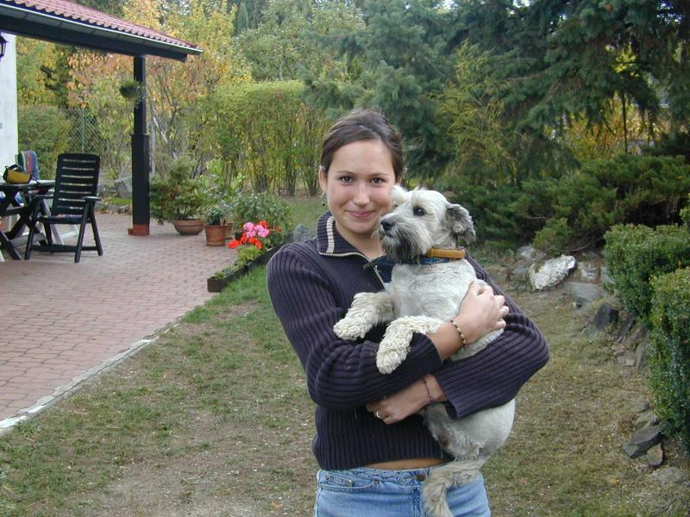
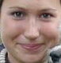
Face recognition: once you’ve detected and cropped a face, try to recognize it
Detection
Recognition
“Sally”

Slide 3
Face recognition: overview
Typical scenario: few examples per face, identify or verify test example
What’s hard: changes in expression, lighting, age, occlusion, viewpoint
Basic approaches (all nearest neighbor)
Project into a new subspace (or kernel space) (e.g., “Eigenfaces”=PCA)
Measure face features

Slide 4
Typical face recognition scenarios
Verification: a person is claiming a particular identity; verify whether that is true
E.g., security
Closed-world identification: assign a face to one person from among a known set
General identification: assign a face to a known person or to “unknown”

Slide 5
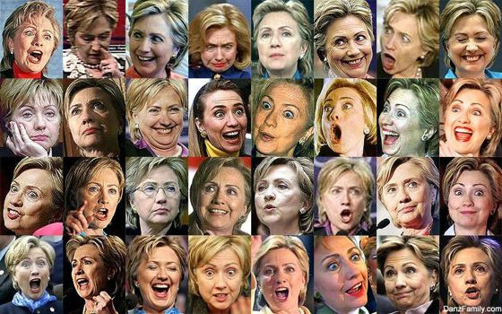
What makes face recognition hard?
Expression

Slide 6






Slide 7




What makes face recognition hard?
Lighting

Slide 8

What makes face recognition hard?
Occlusion

Slide 9
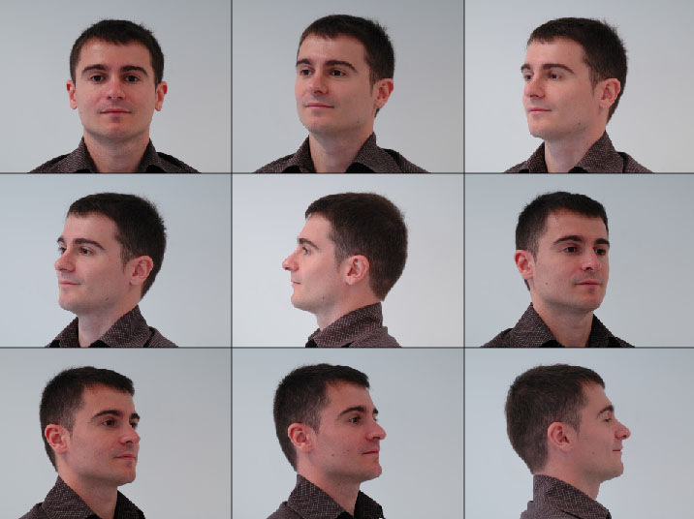
What makes face recognition hard?
Viewpoint

Slide 10
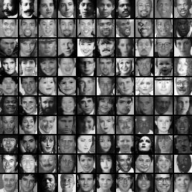
Simple idea for face recognition
Treat face image as a vector of intensities
Recognize face by nearest neighbor in database

Slide 11
The space of all face images
When viewed as vectors of pixel values, face images are extremely high-dimensional
100x100 image = 10,000 dimensions
Slow and lots of storage
But very few 10,000-dimensional vectors are valid face images
We want to effectively model the subspace of face images

Slide 12
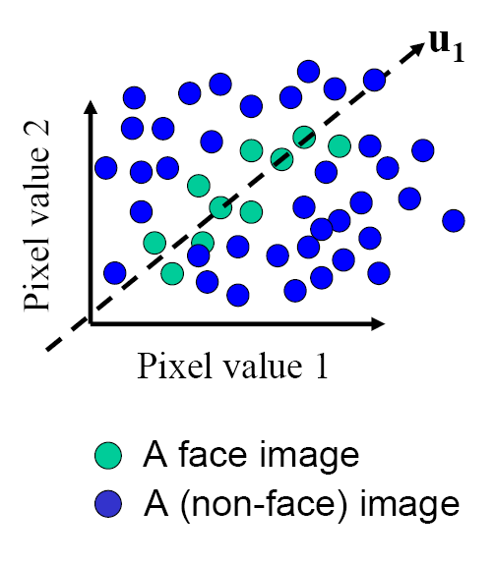
The space of all face images
Eigenface idea: construct a low-dimensional linear subspace that best explains the variation in the set of face images

Slide 13
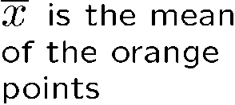
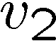


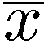
Linear subspaces
Pixel 2
v₁ is the major direction of the orange
points and v₂ is perpendicular to v_{1.}
Convert x into v₁, v₂ coordinates
What does the v₂ coordinate measure?
distance to line
use it for classification—near 0 for orange pts
What does the v₁ coordinate measure?
position along line
use it to specify which orange point it is
Pixel 1
Classification (to what class does x belong) can be expensive
Big search problem
Suppose the data points are arranged as above
Idea—fit a line, classifier measures distance to line
Selected slides adapted from Steve Seitz, Linda Shapiro, Raj Rao

Slide 14
Dimensionality reduction
Pixel 2
Pixel 1
Dimensionality reduction
We can represent the orange points with only their v₁ coordinates
since v₂ coordinates are all essentially 0
This makes it much cheaper to store and compare points
A bigger deal for higher dimensional problems (like images!)

Slide 15
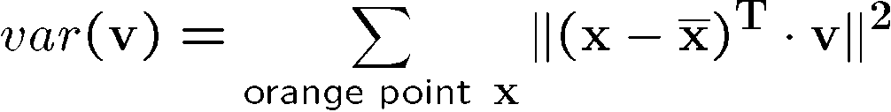
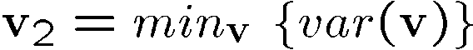

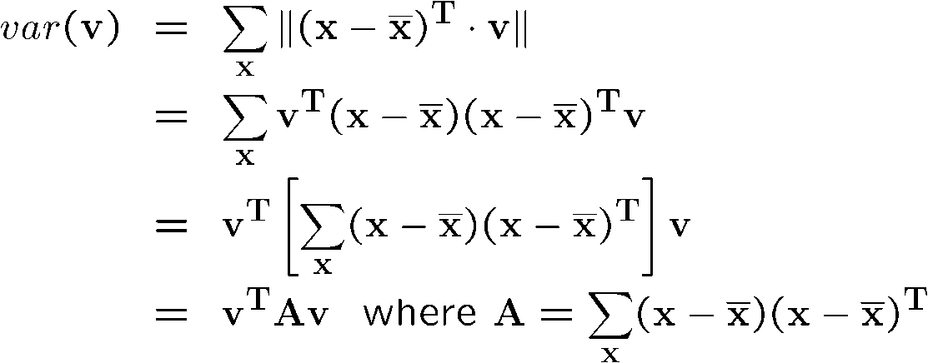
Eigenvectors and Eigenvalues
Pixel 2
Consider the variation along a direction v among all of the orange points:
What unit vector v minimizes var?
What unit vector v maximizes var?
Pixel 1
2
A = covariance matrix of data points (if divided by no. of points)
Solution: v₁ is eigenvector of A with largest eigenvalue
v₂ is eigenvector of A with smallest eigenvalue

Slide 16
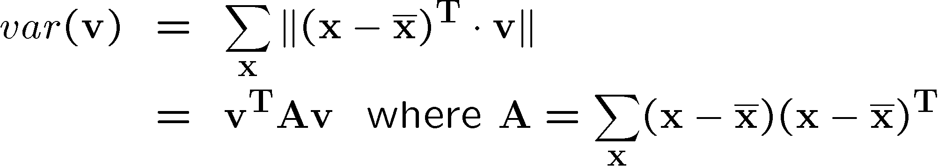
Principal component analysis (PCA)
Suppose each data point is N-dimensional
Same procedure applies:
The eigenvectors of A define a new coordinate system
eigenvector with largest eigenvalue captures the most variation among training vectors x
eigenvector with smallest eigenvalue has least variation
We can compress the data by only using the top few eigenvectors
corresponds to choosing a “linear subspace”
represent points on a line, plane, or “hyper-plane”
these eigenvectors are known as the principal components

Slide 17
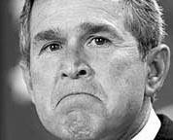
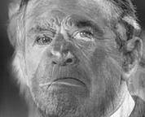
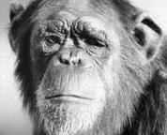
The space of faces
An image is a point in a high dimensional space
An N x M image is a point in R^{NM}
We can define vectors in this space as we did in the 2D case

Slide 18
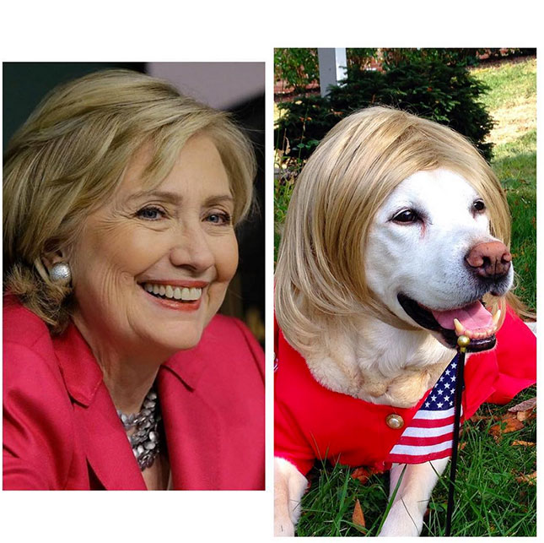
Dimensionality reduction
The set of faces is a “subspace” of the set of images
Suppose it is K dimensional
We can find the best subspace using PCA
This is like fitting a “hyper-plane” to the set of faces
spanned by vectors v₁, v₂, ..., v_{K}
any face

Slide 19
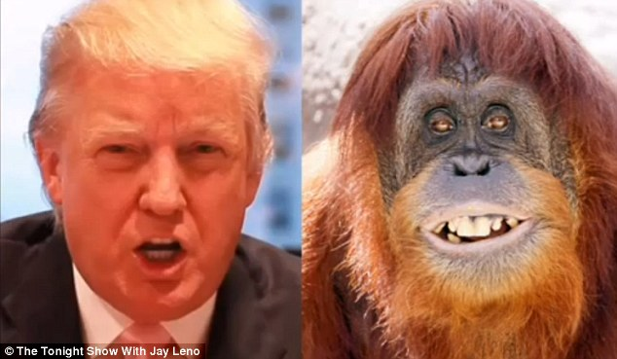
Dimensionality reduction
The set of faces is a “subspace” of the set of images
Suppose it is K dimensional
We can find the best subspace using PCA
This is like fitting a “hyper-plane” to the set of faces
spanned by vectors v₁, v₂, ..., v_{K}
any face

Slide 20
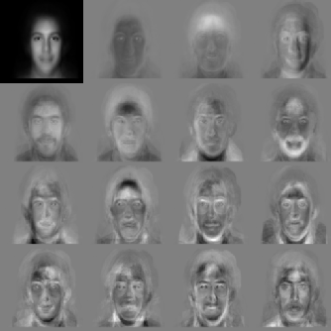


Eigenfaces
PCA extracts the eigenvectors of A
Gives a set of vectors v₁, v₂, v₃, ...
Each one of these vectors is a direction in face space
what do these look like?

Slide 21
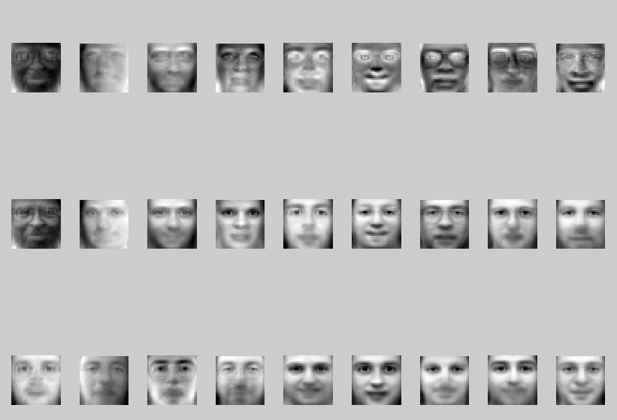
Visualization of eigenfaces
Principal component (eigenvector) u_{k}
μ + 3σ_{k}u_{k}
μ – 3σ_{k}u_{k}

Slide 22
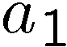
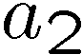

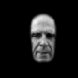
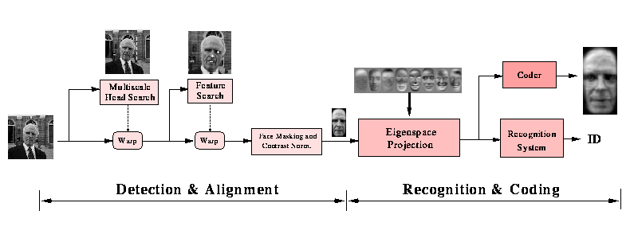
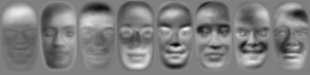


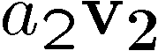
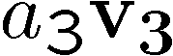
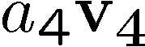
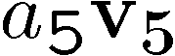

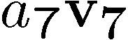

Projecting onto the eigenfaces
The eigenfaces v₁, ..., v_{K} span the space of faces
A face is converted to eigenface coordinates by

Slide 23
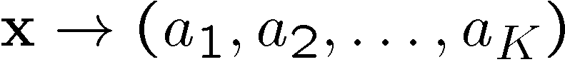
Recognition with eigenfaces
Algorithm
Process the image database (set of images with labels)
Run PCA—compute eigenfaces
Calculate the K coefficients for each image
Given a new image (to be recognized) x, calculate K coefficients
Detect if x is a face
If it is a face, who is it?
Find closest labeled face in database
Nearest-neighbor in K-dimensional space

Slide 24
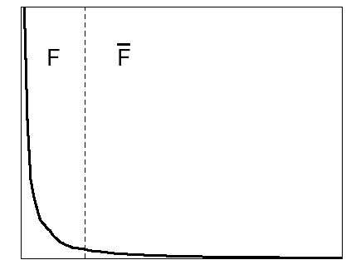
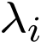
Choosing the dimension K
eigenvalues
i =
K
NM
How many eigenfaces to use?
Look at the decay of the eigenvalues
the eigenvalue tells you the amount of variance “in the direction” of that eigenface
ignore eigenfaces with low variance

Slide 25
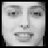
Representation and reconstruction
Face x in “face space” coordinates:
=

Slide 26
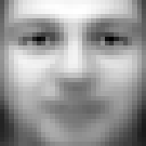
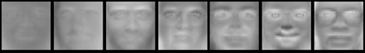
Representation and reconstruction
Face x in “face space” coordinates:
Reconstruction:
=
=
+
^
x
=
µ + w₁u₁+w₂u₂+w₃u₃+w₄u₄+ …

Slide 27
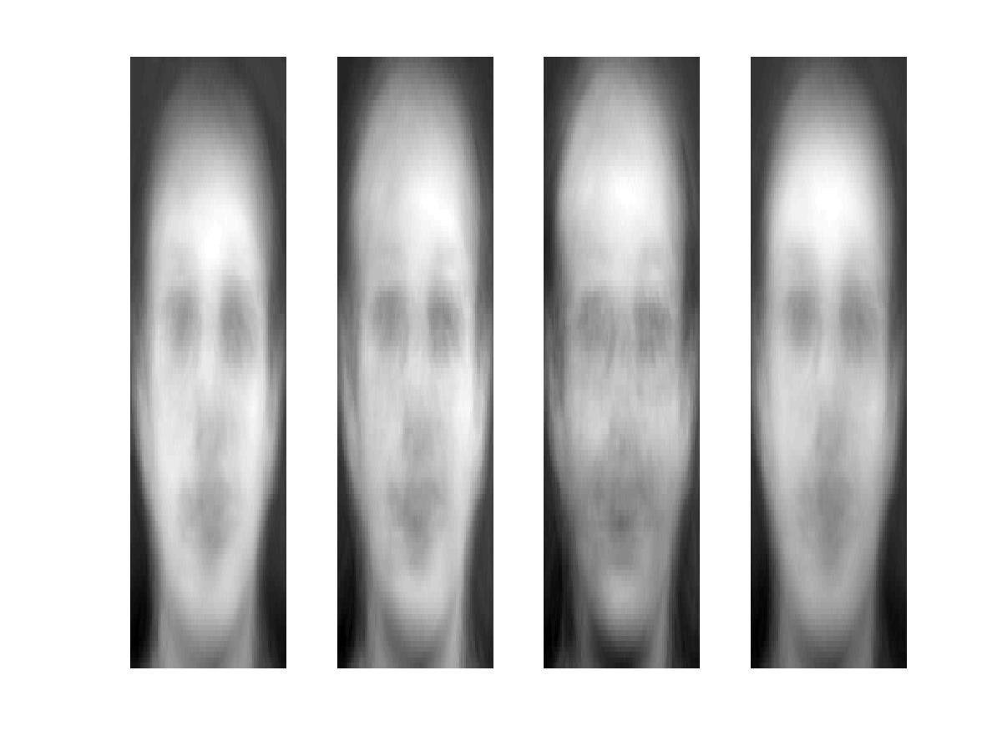
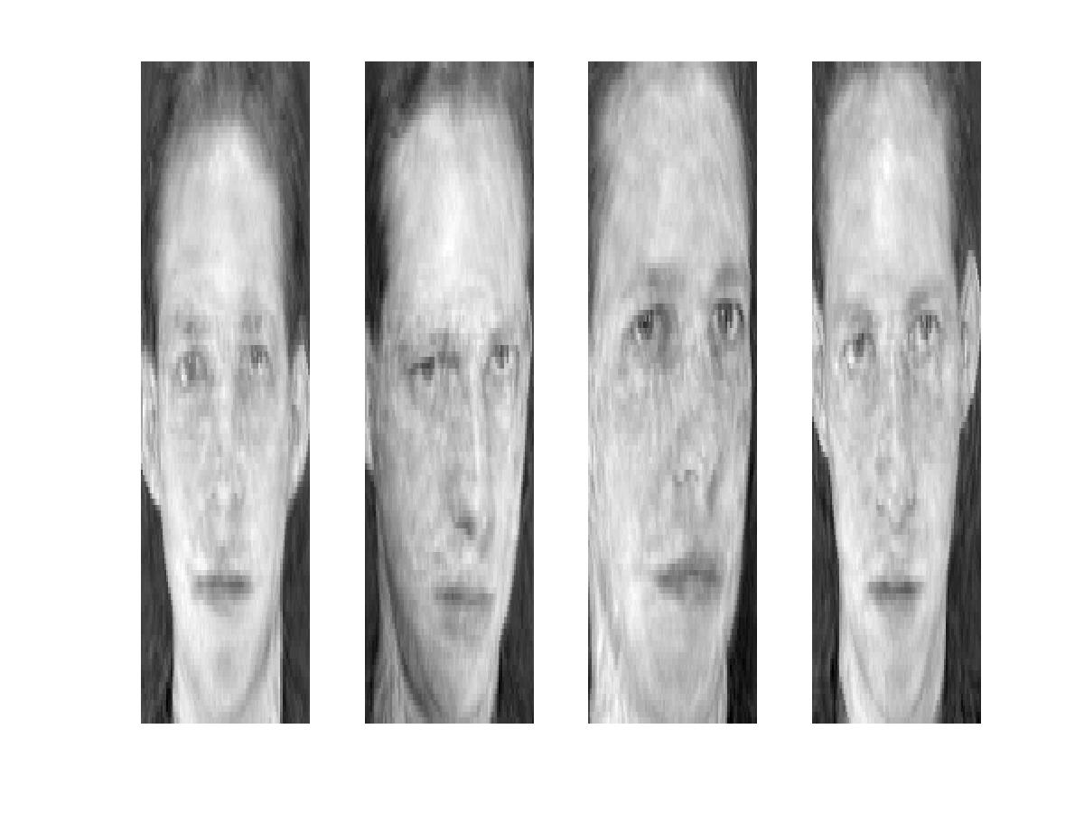
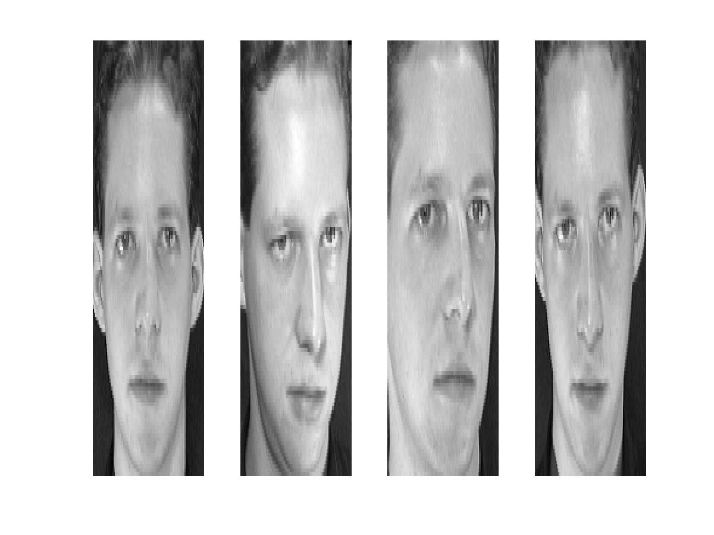
Reconstruction
P = 4
P = 200
P = 400
After computing eigenfaces using 400 face images from ORL face database

Slide 28
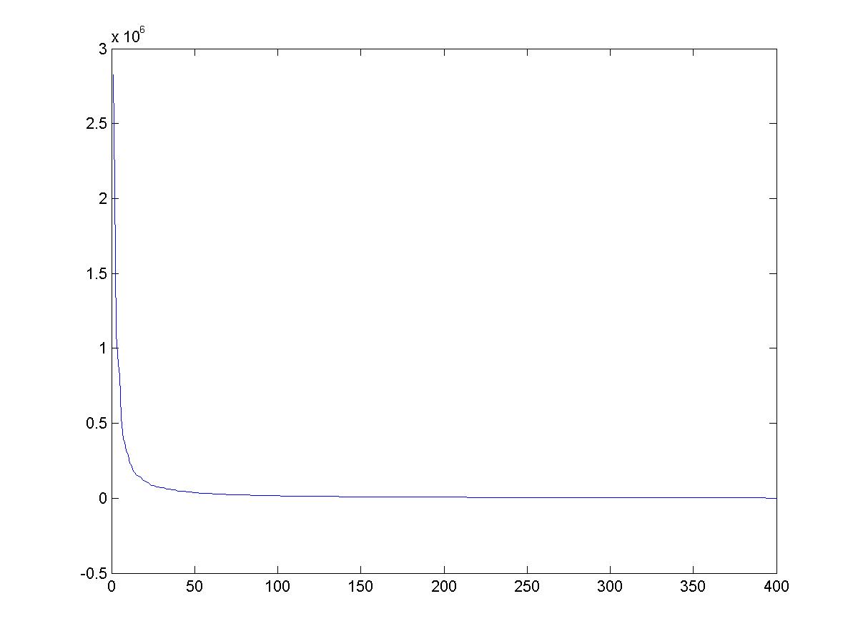
Eigenvalues (variance along eigenvectors)

Slide 29
Note
Preserving variance (minimizing MSE) does not necessarily lead to qualitatively good reconstruction.
P = 200

Slide 30
Recognition with eigenfaces
Process labeled training images
Find mean µ and covariance matrix Σ
Find k principal components (eigenvectors of Σ) u₁,…u_{k}
Project each training image x_{i} onto subspace spanned by principal components: (w_{i1},…,w_{ik}) = (u₁^{T}(x_{i} – µ), … , u_{k}^{T}(x_{i} – µ))
Given novel image x
Project onto subspace: (w₁,…,w_{k}) = (u₁^{T}(x – µ), … , u_{k}^{T}(x – µ))
Optional: check reconstruction error x – x to determine whether image is really a face
Classify as closest training face in k-dimensional subspace
^
M. Turk and A. Pentland, Face Recognition using Eigenfaces, CVPR 1991

Slide 31
PCA
General dimensionality reduction technique
Preserves most of variance with a much more compact representation
Lower storage requirements (eigenvectors + a few numbers per face)
Faster matching
What other applications?

Slide 32
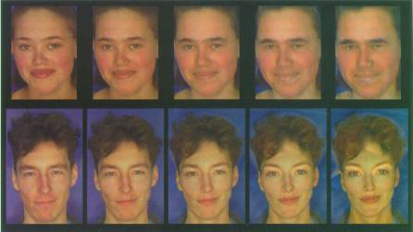
Enhancing gender
more same original androgynous more opposite
D. Rowland and D. Perrett, “Manipulating Facial Appearance through Shape and Color,” IEEE CG&A, September 1995
Slide credit: A. Efros

Slide 33
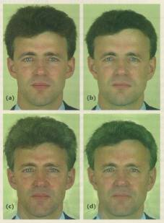
Changing age
Face becomes “rounder” and “more textured” and “grayer”
original shape
color both
D. Rowland and D. Perrett, “Manipulating Facial Appearance through Shape and Color,” IEEE CG&A, September 1995
Slide credit: A. Efros

Slide 34
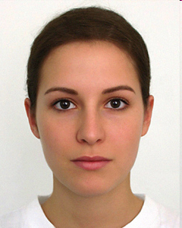
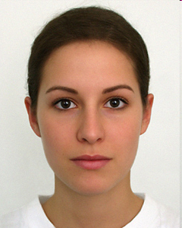
Which face is more attractive?
http://www.beautycheck.de

Slide 35
Use in Cleft Severity Analysis
We have a large database of normal 3D faces.
We construct their principal components.
We can reconstruct any normal face accurately using these components.
But when we reconstruct a cleft face from the normal components, there is a lot of error.
This error can be used to measure the severity of the cleft.

Slide 36
Use of PCA Reconstruction Error to Judge Cleft Severity

Slide 37
Question
Would PCA on image pixels work well as a general compression technique?
P = 200

Slide 38
Extension to 3D Objects
Murase and Nayar (1994, 1995) extended this idea to 3D
objects.
The training set had multiple views of each object, on a
dark background.
The views included multiple (discrete) rotations of the object on
a turntable and also multiple (discrete) illuminations.
The system could be used first to identify the object and then to
determine its (approximate) pose and illumination.

Slide 39
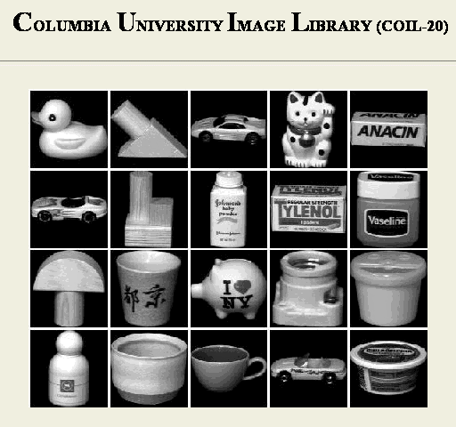
Sample Objects Columbia Object Recognition Database

Slide 40
Significance of this work
The extension to 3D objects was an important contribution.
Instead of using brute force search, the authors observed that
All the views of a single object, when transformed into the
eigenvector space became points on a manifold in that space.
Using this, they developed fast algorithms to find the closest
object manifold to an unknown input image.
Recognition with pose finding took less than a second.

Slide 41
Appearance-Based Recognition
Training images must be representative of the instances
of objects to be recognized.
The object must be well-framed.
Positions and sizes must be controlled.
Dimensionality reduction is needed.
It is not powerful enough to handle general scenes
without prior segmentation into relevant objects.
* The newer systems that use “parts” from interest operators
are an answer to these restrictions.

